Slide 1


HAZARDOUS WASTE TREATMENT AND MANAGEMENT
Hindustan Copper Limited
Malanjkhand, dist.- Balaghat, M.P.
Presented by : Satyam Rahangdale (22CH10062)

Slide 2
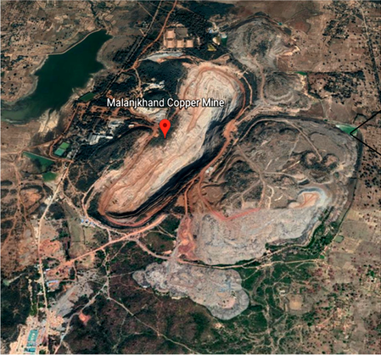
Contents
Introduction
Overview of the process
Hazardous wastes generated
Treatment
Waste Water Treatment : Chemical Precipitation method

Slide 3
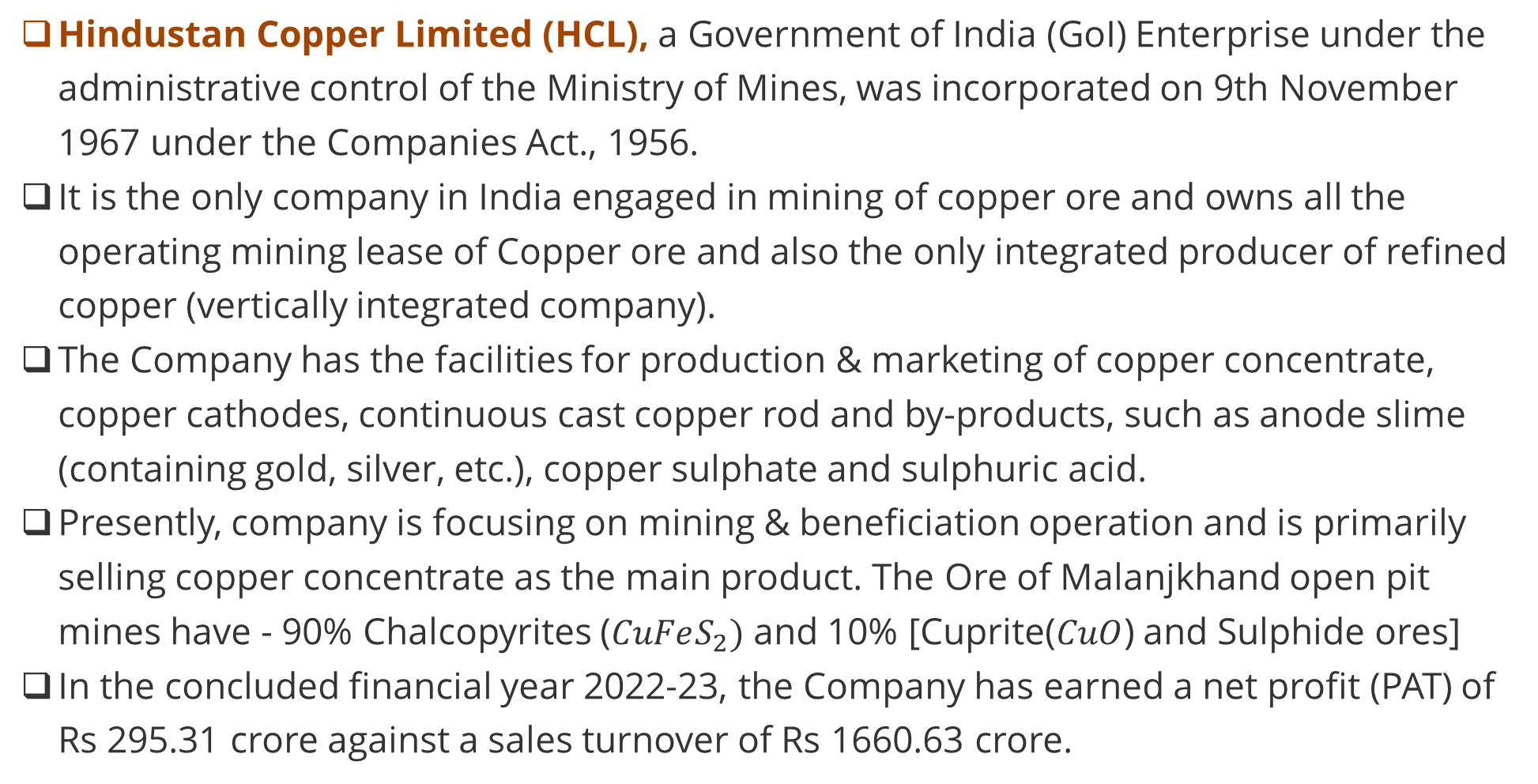
Introduction
Hindustan Copper Limited (HCL), a Government of India (GoI) Enterprise under the administrative control of the Ministry of Mines, was incorporated on 9th November 1967 under the Companies Act., 1956.
It is the only company in India engaged in mining of copper ore and owns all the operating mining lease of Copper ore and also the only integrated producer of refined copper (vertically integrated company).
The Company has the facilities for production & marketing of copper concentrate, copper cathodes, continuous cast copper rod and by-products, such as anode slime (containing gold, silver, etc.), copper sulphate and sulphuric acid.
Presently, company is focusing on mining & beneficiation operation and is primarily selling copper concentrate as the main product. The Ore of Malanjkhand open pit mines have - 90% Chalcopyrites ($CuFeS_{2})$ and 10% [Cuprite($CuO$) and Sulphide ores]
In the concluded financial year 2022-23, the Company has earned a net profit (PAT) of Rs 295.31 crore against a sales turnover of Rs 1660.63 crore.

Slide 4
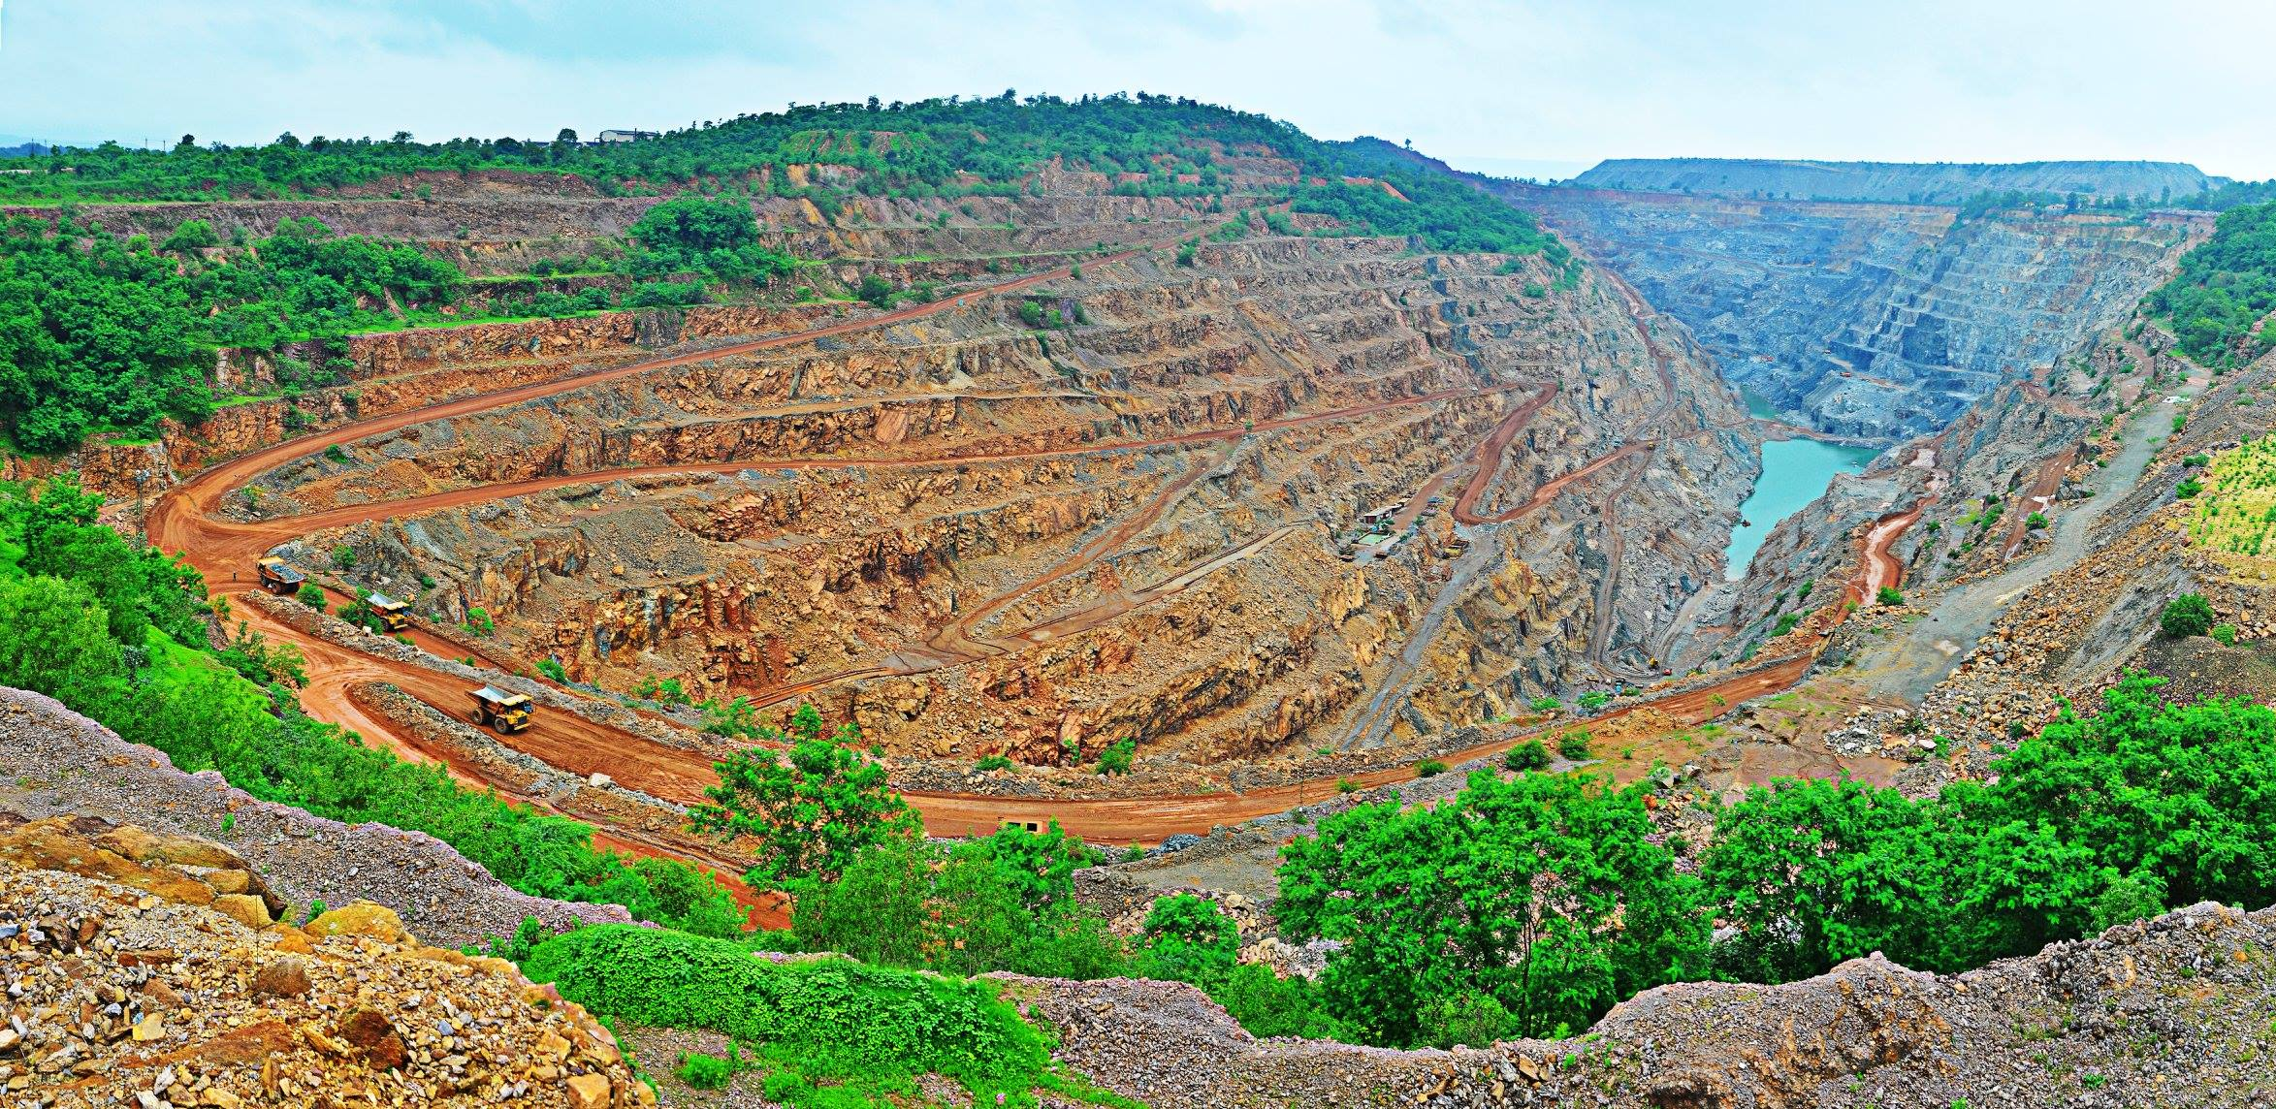

Slide 5
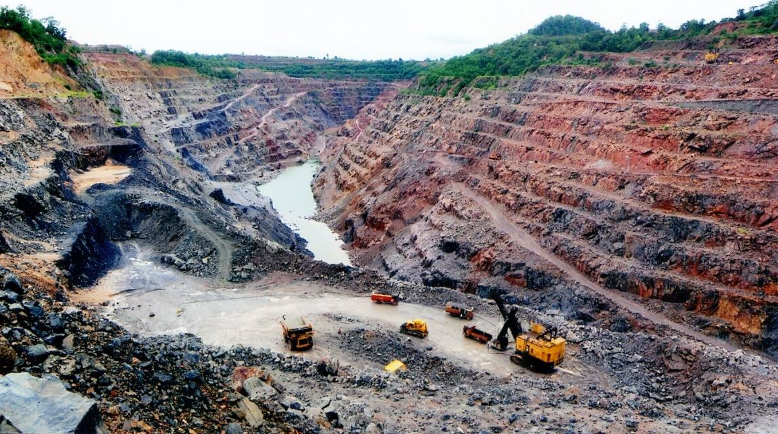

Slide 6
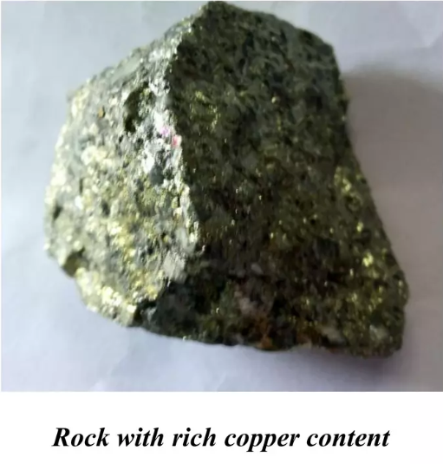
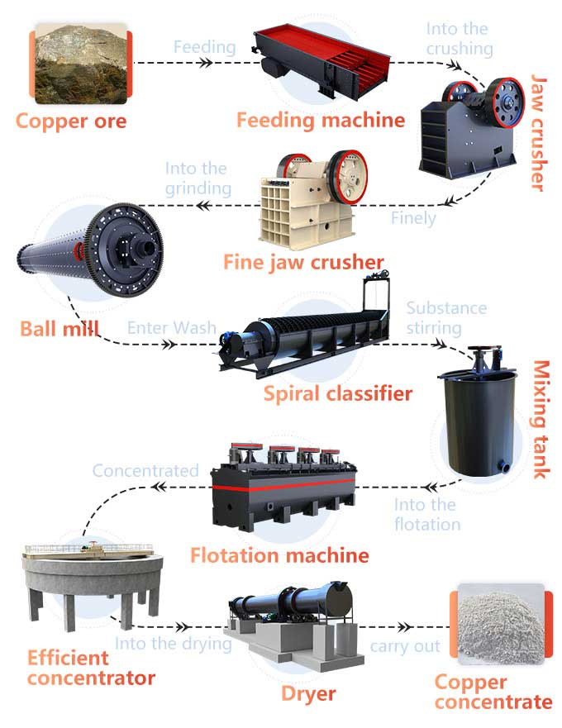
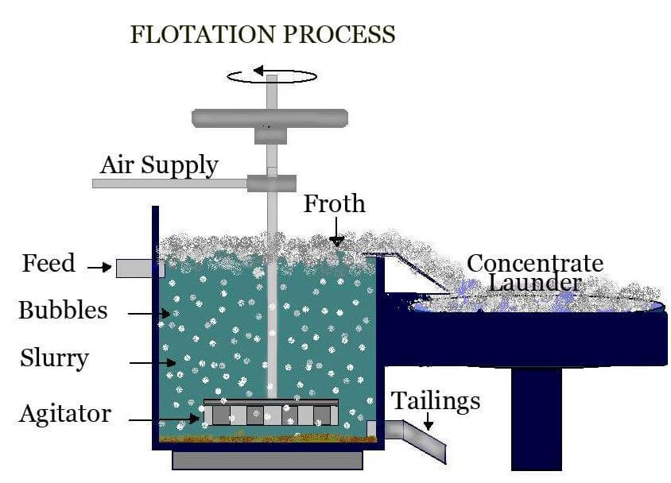
Overview of Process

Slide 7
Hazardous Waste Generated
Type of Hazardous Waste | Source of Hazardous Waste | Potential Hazards
Plastic Waste | Packaging, Insulation, waste rubber and storage containers for transport | Non-biodegradable, environmental pollution, microplastics
E-waste | Discarded electronics, batteries, circuit boards | Toxic metals like lead, mercury, Nickel and cadmium and their oxides
Bio-medical waste | Medical facilities and first-aid stations within the mine | Infectious diseases, sharp injuries, chemical exposure
Dust (PM-2.5 and PM-10) | Primary and secondary Crusher(Jaw crusher and Ball mill) And Blasting for mining | Eye irritation, skin allergies, and nasal congestion, Occupational lung diseases, coughing, throat irritation, and breathing difficulties
SO_{x} , NO_{x} and CO | Machineries, transport vehicles moving across the mine and Blasting | Acid rain, Smog, causing coughing and throat irritation and lungs inflamation
Spent Oil | Machineries, transport vehicles and conveyor belts | Water contamination, release toxic gases on burning, poisoning if ingested.
Waste Water containing Cu, Fe, Mn and fluorides. (acidic) | Flotation machine, Concentrator | Groundwater contamination, soil degradation, toxic to plants and animals.

Slide 8
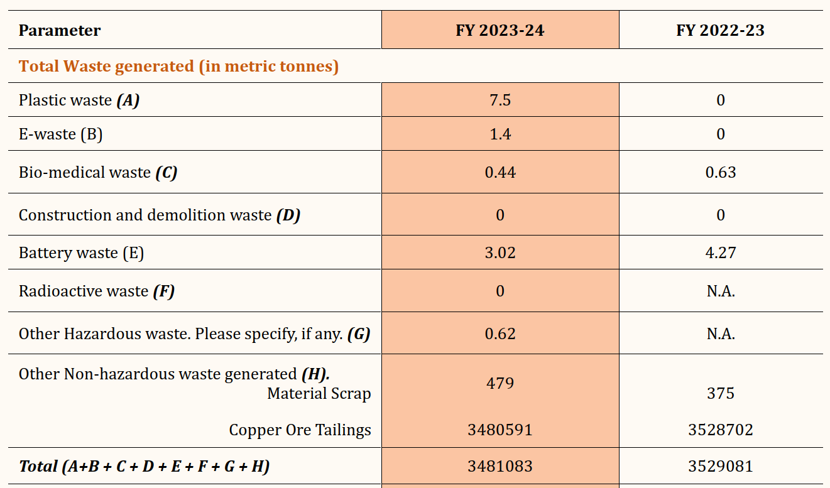
Source : Sustainability Report 2023-24, HCL

Slide 9
Type of Hazardous Waste Generated | Treatment
Plastic Waste | Sold through M/s MSTC Ltd.’s tendering process
E-waste | Handed over to parties authorized by the Pollution Control Board (PCB).
Bio-medical waste | Handed over to a Common Bio-medical Waste Treatment Facility (CBWTF) authorized by the PCB.
Dust (PM-2.5 and PM-10) | Water is sprinkled in the surrounding area to settle down these particles
Spent Oil | Sold to a PCB authorized recycler
Tailings (residue of ore) | Used for backfilling in the mine to fill the voids generated during mining operations
Waste Water containing Cu, Fe, Mn and fluorides. (acidic) | Proper treatment of waste water is done before discharging to surface water to avoid contamination

Slide 10
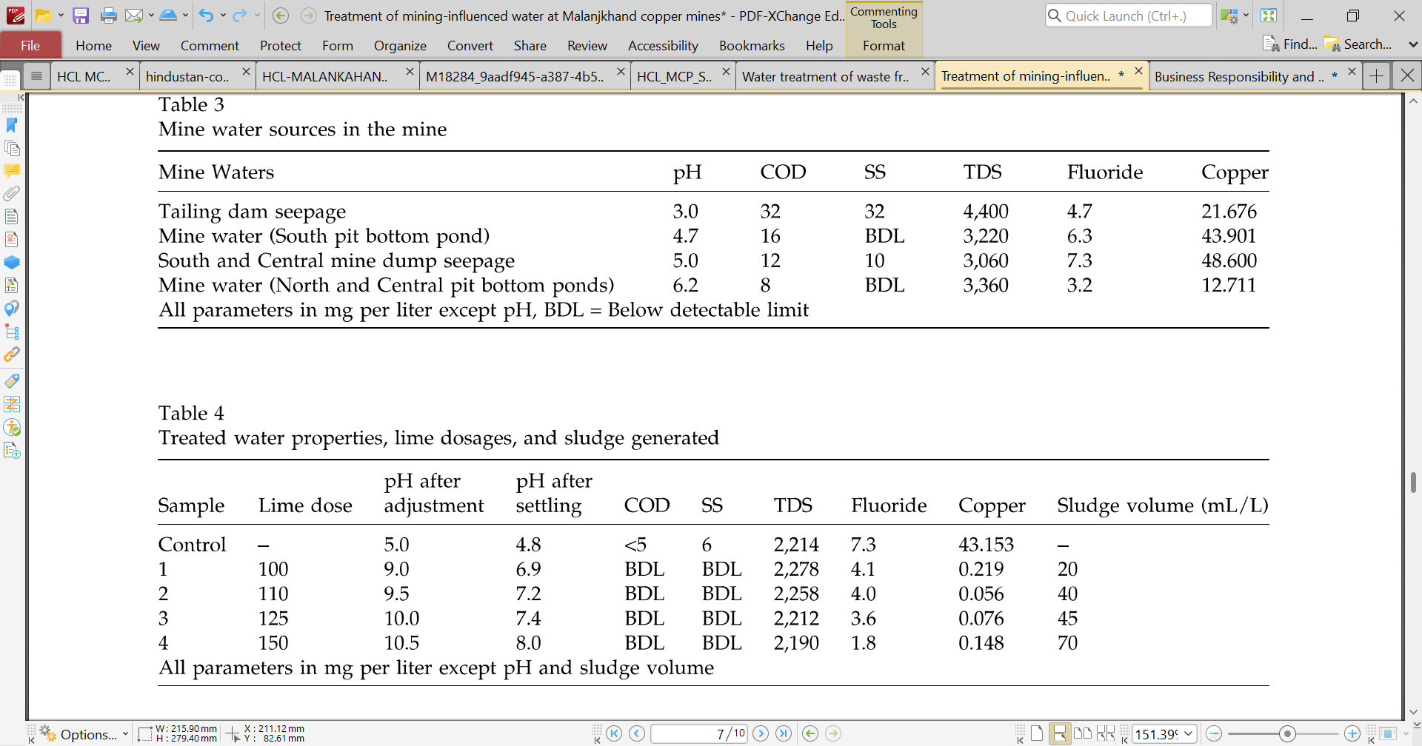
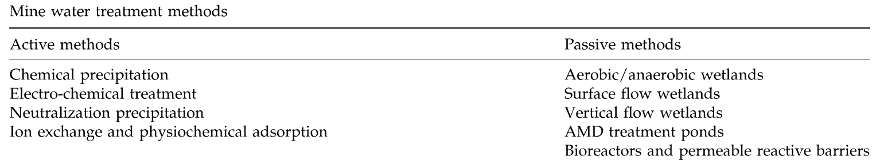
Waste water Treatment

Slide 11
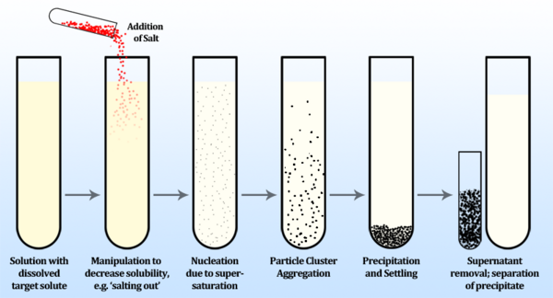
Chemical Precipitation for Waste water Treatment

Slide 12
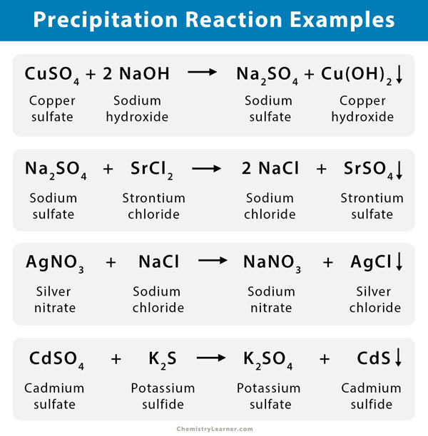
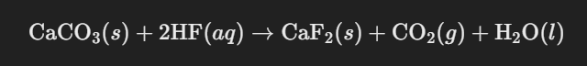
Chemical Precipitation for Waste water Treatment
The most widely used method for removing copper and fluoride is precipitation as insoluble hydroxide or salt at alkaline pH.

Slide 13
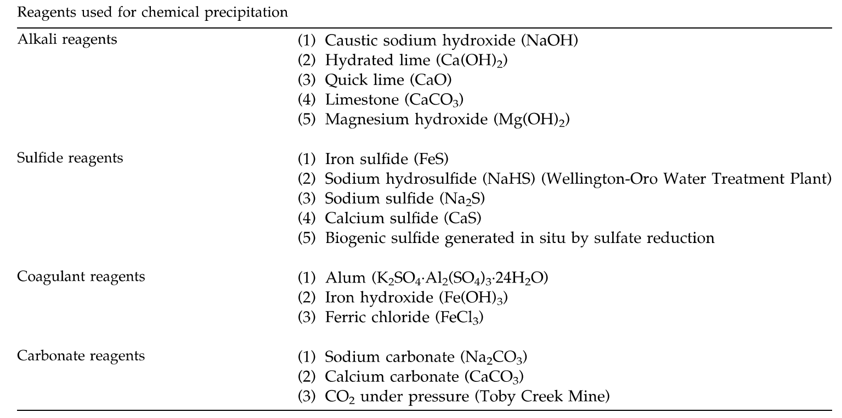

Slide 14
Results of Chemical Precipitation

Slide 15
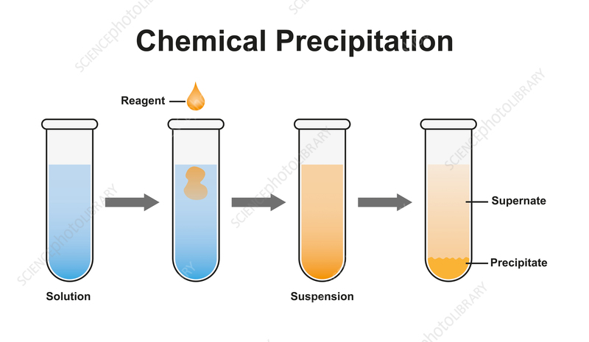

Slide 16
Mining
Transporting
Crushing
Froth Floatation
Heap Leaching
Thickening
Solvent Extraction
Oxide Ore: Hydrometallurgy
Sulfide Ore: Pyrometallurgy
Smelting
Electrowinning
Final Product:
99.99% pure copper cathode
Electrolysis

Slide 17
